Slide 1
Hierarchical Objects

Slide 2
Many objects in 3D graphics, game characters, robots, and so on, consist of more than one object or segment.s

Slide 3
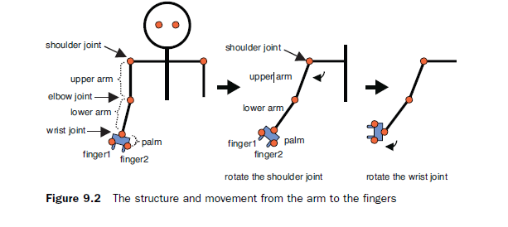
One of the key issues when drawing an object consisting of multiple objects (segments) is that you have to program to avoid conflicts when the segments move.

Slide 4
Drawing and Manipulating Objects Composed of Other Objects
When you move the upper arm by rotating around the shoulder joint, depending on the upper arm movement, the lower arm, palm, and fingers move (the middle of Figure ) accordingly.
When you move the lower arm using an elbow joint, the palm and fingers move but the upper arm does not.
When you move the palm using the wrist joint, both palm and fingers move but the upper and lower arm do not (the right of Figure ).
When you move fingers, the upper arm, lower arm, and palm do not move.

Slide 5
The typical method used to draw and manipulate the object with such features is to draw each part object (such as a box) in the order of the object’s hierarchical structure from upper to lower, applying each model matrix (rotation matrix) at every joint.

Slide 6
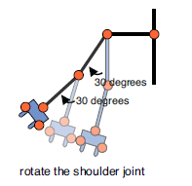
Rotation of one segment propagates to the lower segments and simply requires that you use the same model matrix for the rotation of the lower segments.
The upper segments are not affected by rotation of the lower segments. Thus, the upper segments will not move no matter how much the lower segments move.

Slide 7
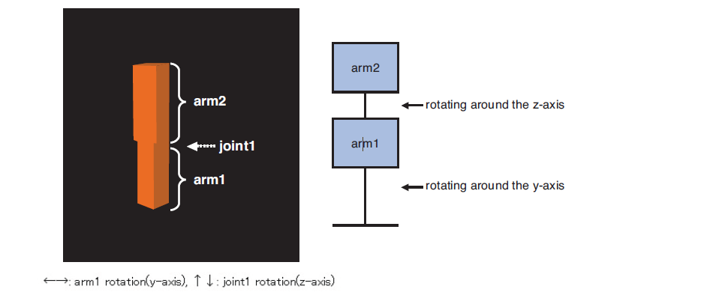
Single Joint Model

Slide 8
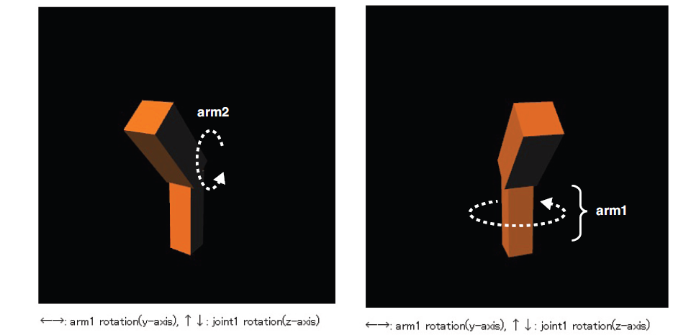
The movement of arm2 by rotation of joint1 does not affect arm1.
In contrast, arm2 is rotated if you rotate arm1.

Slide 9
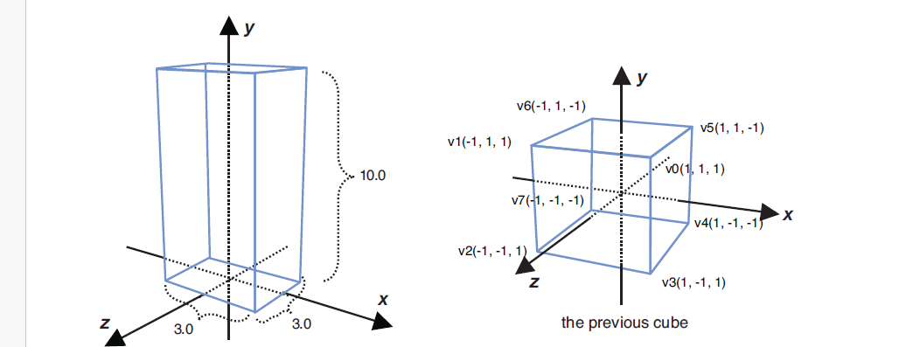

Slide 10
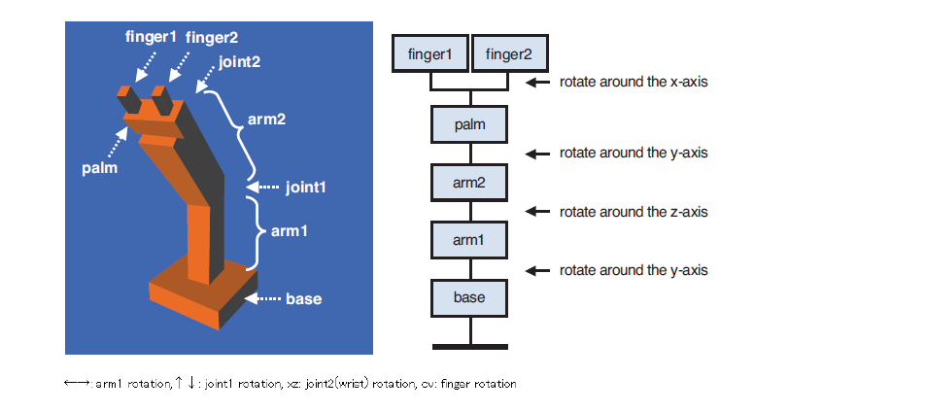
MultiJoint Model

